Slide 1
GRAPE DISEASE DETECTION AND CLASSIFICATION
CMPE 257, SPRING 2020
DR. JERRY GAO
Revanth Krishna Maddula
Laxmi Prasanna Palle
Bhavana Obellaneni
Jagan Gadamsetty

Slide 2
Introduction
Grapes are one of the most widely used Fruits in the world, since it is almost used in many products such as Jam, wine and other food Products.
Hence Disease Classification is very important these days, as it takes a lot of manual time and effort, and is a prominent factor in deciding whether the Grape crop is spoilt or not.
This project deals with the exploring various models on the grape disease detection and classification using the different machine learning models.
Project work aims at developing the model which is able to cover even the images taken in different complexions so that the Classification is more dynamic and will suffice for many variations.

Slide 3
Team Tasks and Roles
Images Collected by:
REVANTH: Black rot images
JAGAN: Healthy leaves
PRASANNA: Black measles
BHAVANA: Leaf Blight
Models:
REVANTH : CNN MODEL
JAGAN : VGG16 CNN
PRASANNA: RANDOM FOREST CLASSIFIER
BHAVANA: SUPPORT VECTOR MACHINE

Slide 4
Training and Test data
Positive and negative images of grape leaves, which are affected with diseases.
15422 number of samples along with augmented images.
LabelMe tool is used for annotation of images.
80-20 split for training & testing, 20% of training data used for validation.

Slide 5
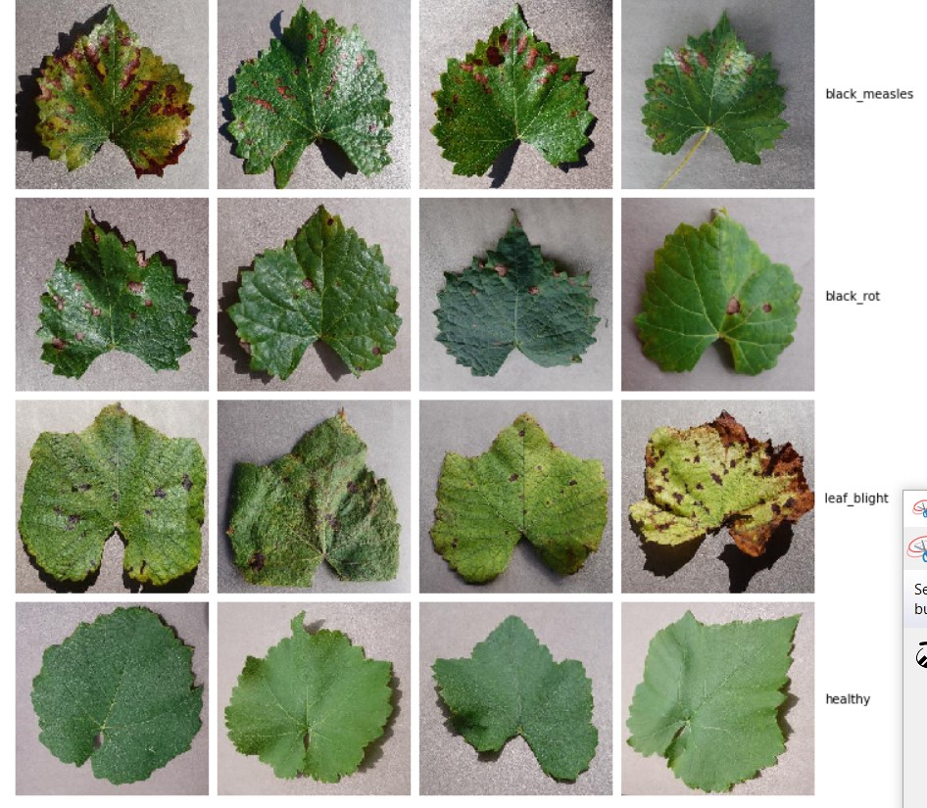
Different classes

Slide 6
Samples of Train and Test data- Before Augmentation and Addition of data samples
DISEASE | NUMBER OF SAMPLES
BLACK MEASLES | 1433
BLACK ROT | 1530
HEALTHY | 577
LEAF BLIGHT | 1342
Total images: 4890

Slide 7
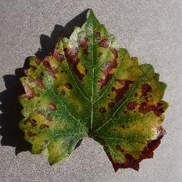
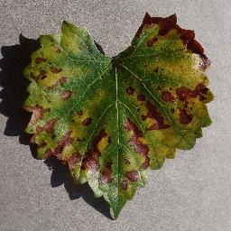
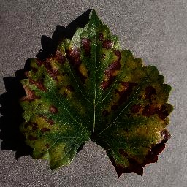
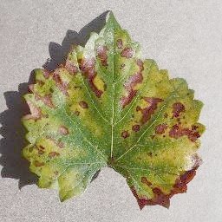
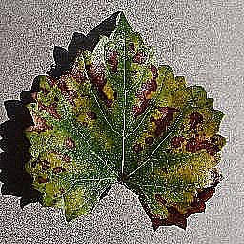
Data Augmentation
Original
Vertical Flip
Gamma correction
Gamma correction
Sharpen
DISEASE | TOTAL SAMPLES (INCLUDING AUGMENTED IMAGES)
BLACK MEASLES | 5621
BLACK ROT | 2910
HEALTHY | 2221
LEAF BLIGHT | 4670
Total images: 15422

Slide 8
Training Data Preparation

Slide 9
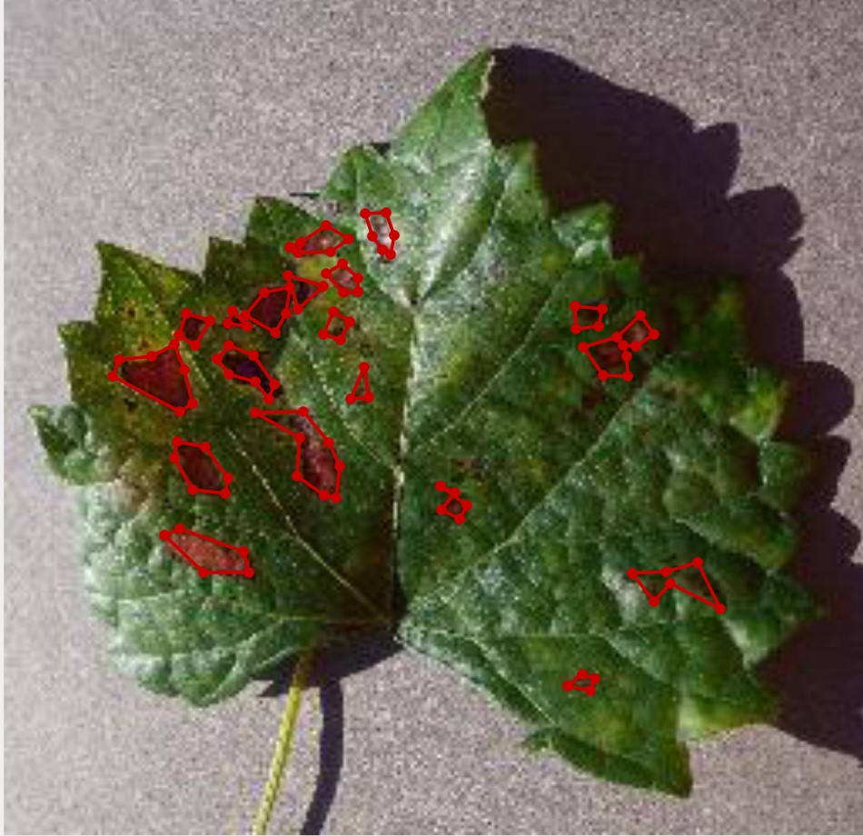
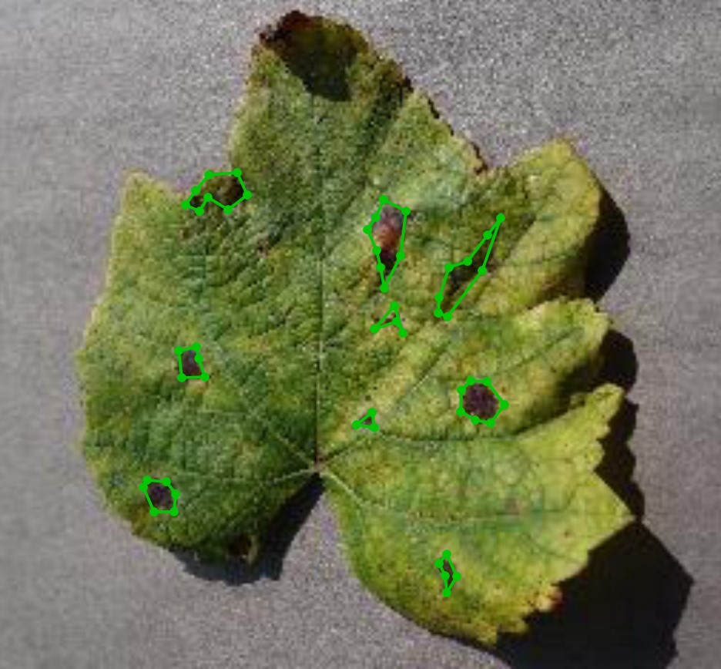
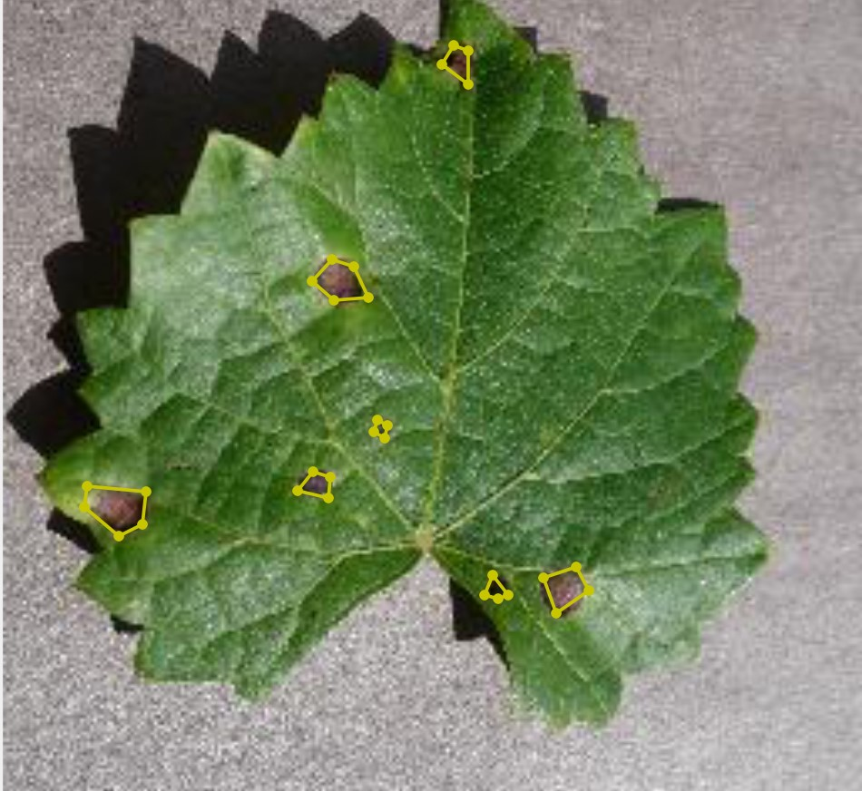
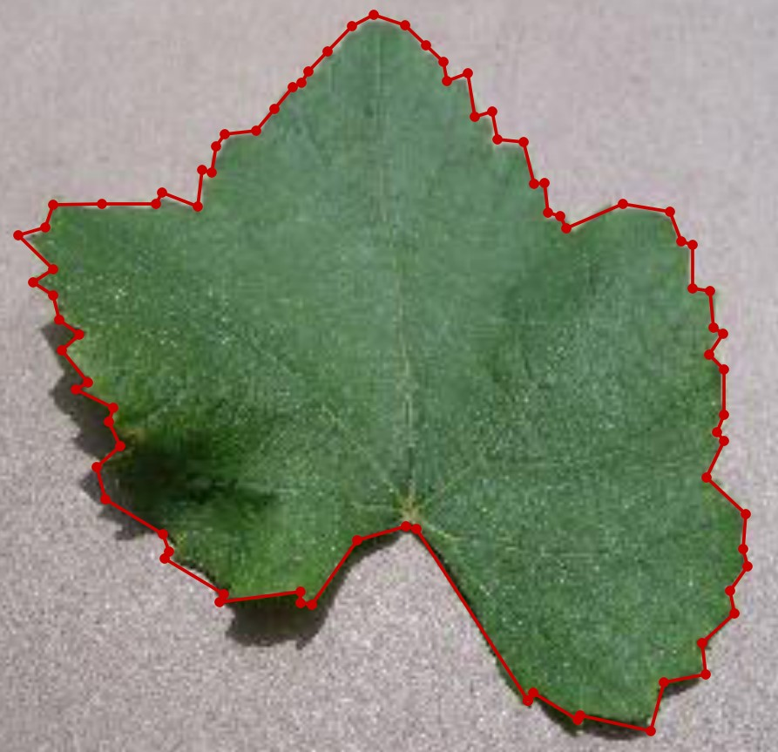
Data Overview - Using Labelme
Black measles
Leaf Blight
Black rot
Healthy

Slide 10
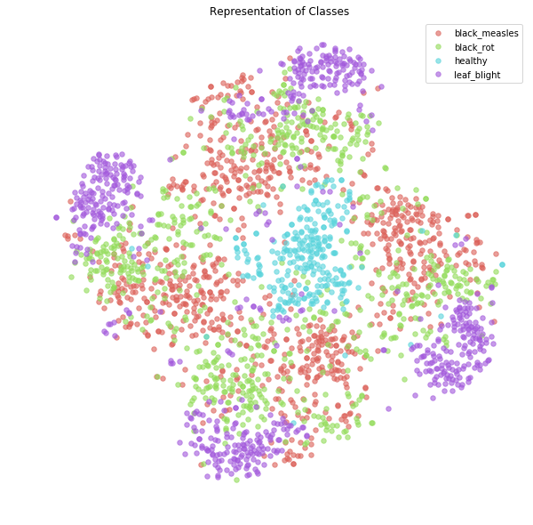
The images are resized into images of 224x224 pixels, then the images are flattened into numpy arrays, since the images cannot be fed directly to the machine learning algorithms.
The validation dataset helps in finetuning the parameters so that efficient training can be performed.

Slide 11
Models and Algorithms
CNN
VGG16 Convolutional neural network
Random Forest
Support Vector Machine

Slide 12
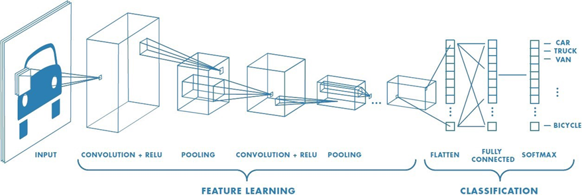
CNN MODEL
Inspired by the neurons in the brain, This model takes the input image, assign weights to different features of the object in order to be able to differentiate one from the another.
The network starts with a bunch of neurons, holding the activation value which is passed on to the next layers bringing the change.
This model is well known for image recognition and classification scenarios.
The input image is passed into convolutional layer-> pooling for dimensionality reduction -> convolutional layers are added if required-> flattened output is fed to a fully connected layer-> Output class to classify images.

Slide 13
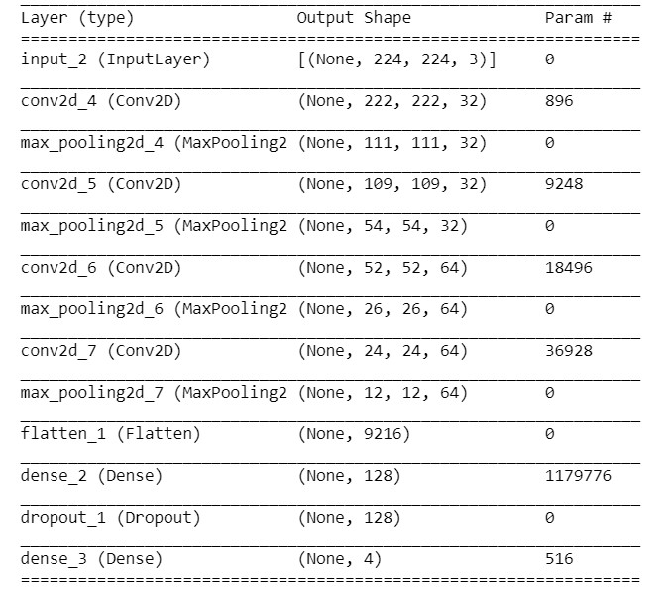
Layers applied in the CNN Model
Layer | Shape
Input | 224x224x3
Conv1- filters=32,kernel size=(3,3), activation=“relu” | 222x222x32
Pool1- max Pooling used of size=(2,2) | 111x111x32
Conv2- filters=32,kernel size=(3,3), activation=“relu” | 109x109x32
Pooling2- max Pooling used of size=(2,2) | 54x54x32
Conv3- filters=64, kernel size=(3,3), activation=“relu” | 52x52x64
Pool3- max Pooling used of size=(2,2) | 26x26x64
Conv4- filters=64,kernel size=(3,3), activation=“relu” | 24x24x64
Pool4- max Pooling used of size=(2,2) | 12x12x64
Flatten() | 9216
Dense | 128
Dropout | 128
Dense- Softmax function | 4

Slide 14
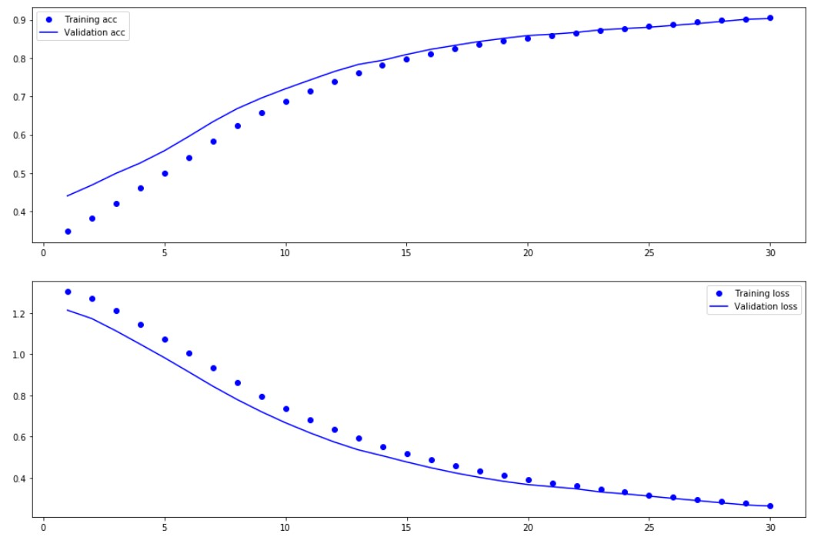
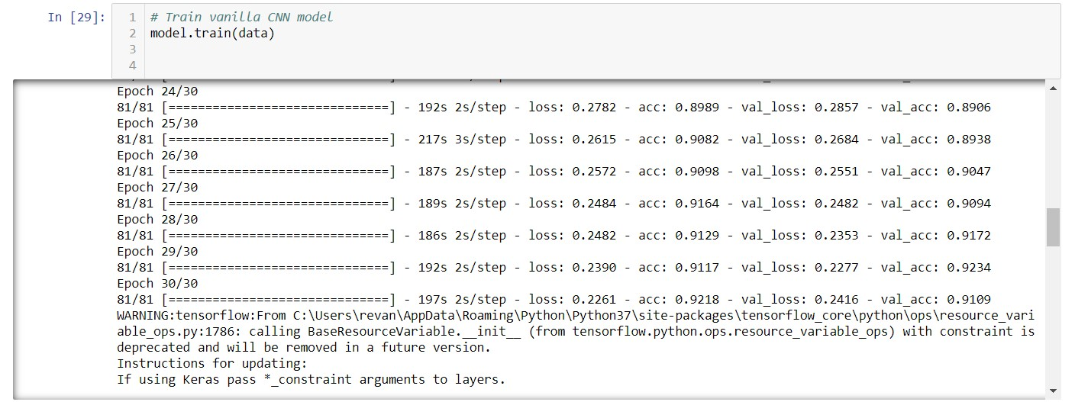
Experimental Results: CNN Model

Slide 15
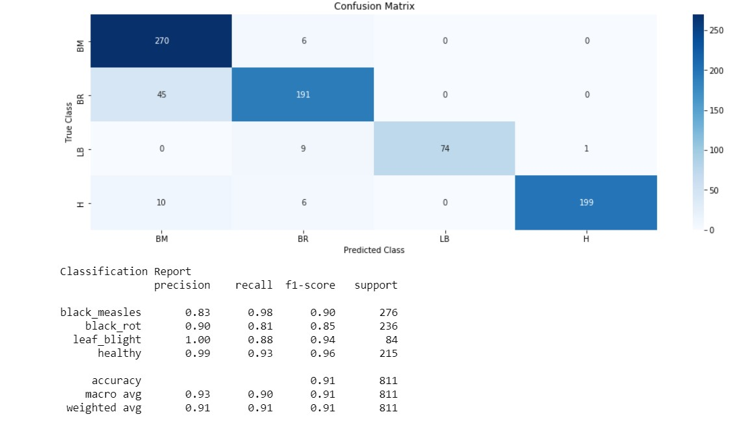

Slide 16
Why CNN?
With the growth of the number of layers in the CNN, computational costs are very high: CNN model reduces this time.
Comparing to the other models, CNN can take the image dataset directly, without the requirement of flattening and RGB2GRAY, before sending it to the machine learning model hence preserving the features of the image dataset. Therefore the pre-processing is much less compared to other algorithms.
The number of features are reduced by using a sliding window of size less than that of the matrix (Dimensionality Reduction). CNN is very suitable for effective classification as the parameters are relatively high in the context of image classification.

Slide 17

VGG16 Convolutional Neural Network
VGG16 Convolutional neural network is a pre-trained framework, which contains 16 layers of depth.
As a result, the network has learned the rich feature representations for a wide range of images.
The network will generally have an image input size of 224x224 pixels.
Since this model divides the images into smaller parts to classify it, the accuracy achieved is generally greater than regular CNN model which makes it more reliable in disease detection.

Slide 18
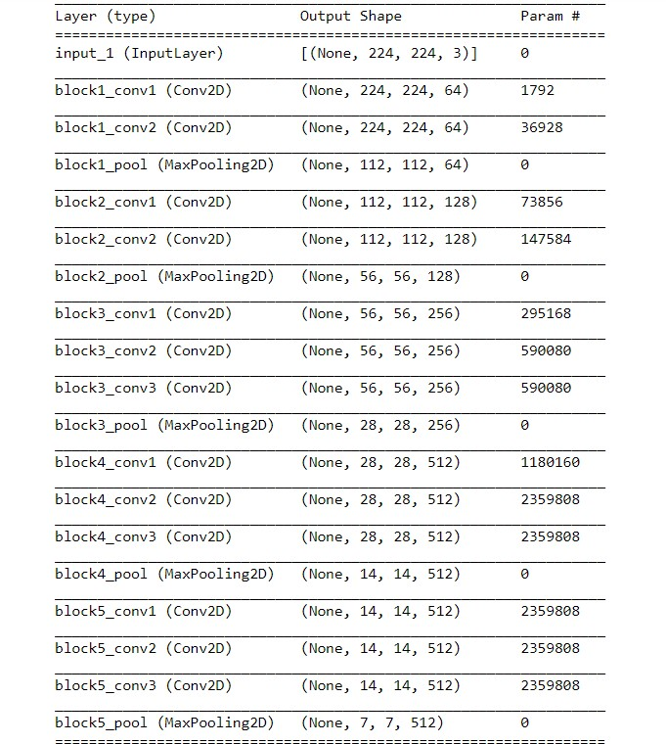
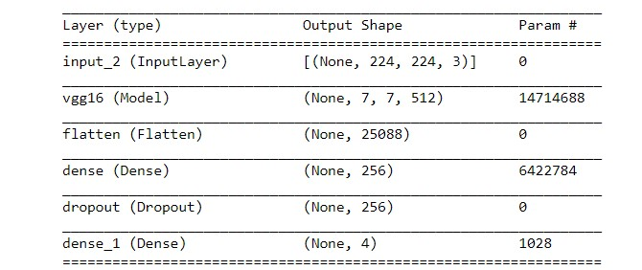
Layers applied in VGG16 Model

Slide 19
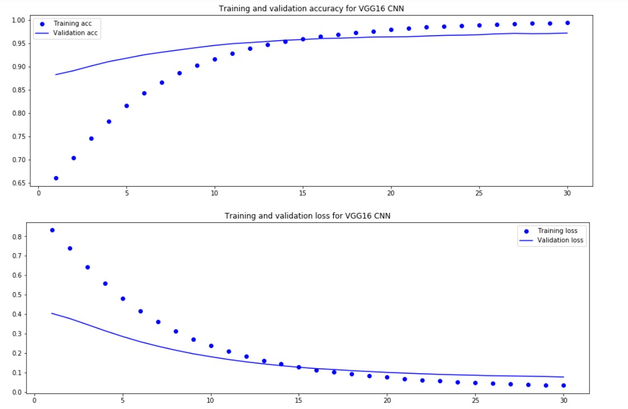
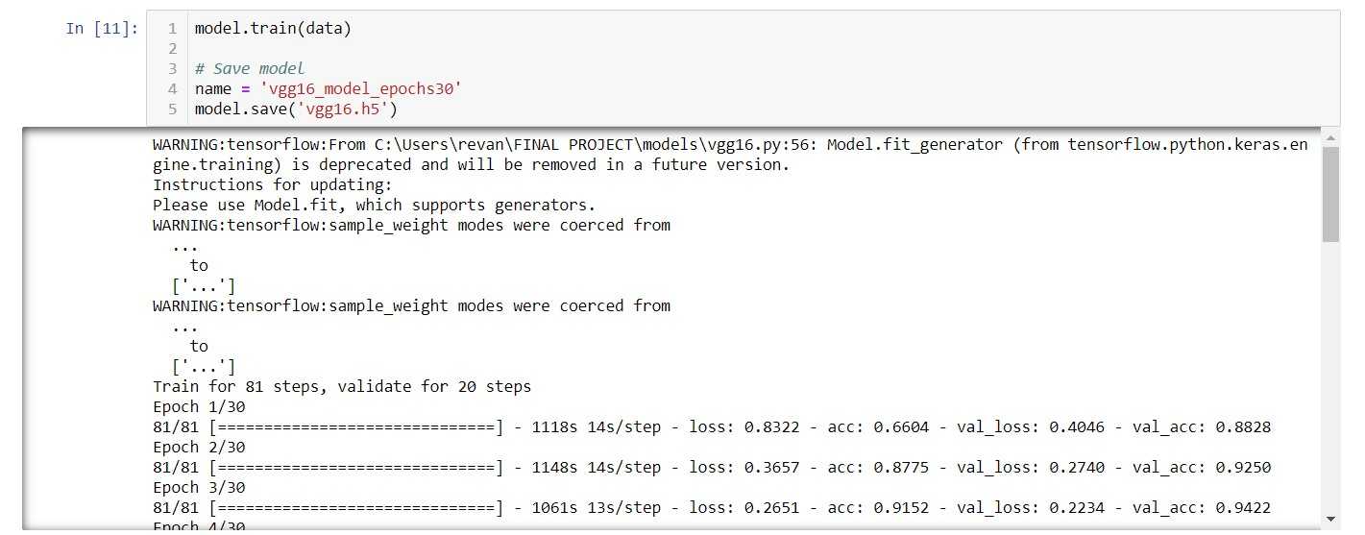
Experimental Results: VGG16 CNN Model

Slide 20
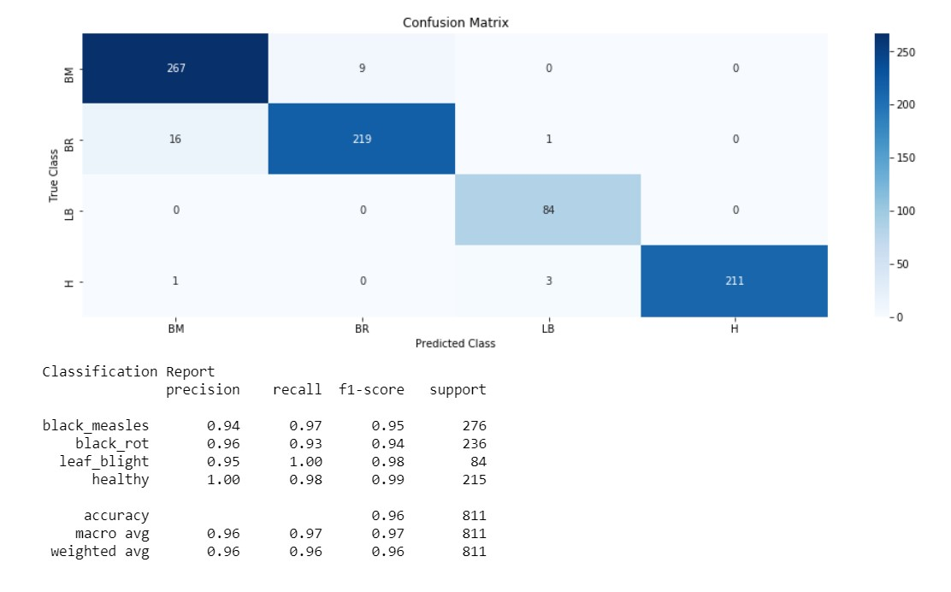

Slide 21
Advantages of VGG16 CNN
The 2 convolutions are stacked together before sending to pooling, hence increasing the non linearity by adding two rectilinear unit activation functions, thereby increasing accuracy in prediction
It is a simple model and can be easily interpreted
Achieves high accuracy since it computes many parameters.

Slide 22
Random Forest Model-Classification
Random forest is a classification algorithm which consists of many uncorrelated decision trees, each tree classifies the data and the one with majority of the votes for the classification becomes the prediction of the model.
It uses bagging and feature randomness.
Bagging is the process of providing random sample of size N with replacement.
Feature randomness is allowing a decision tree in a random forest to select the feature from a random subset instead of trying to test which feature makes the most accurate split of data.

Slide 23
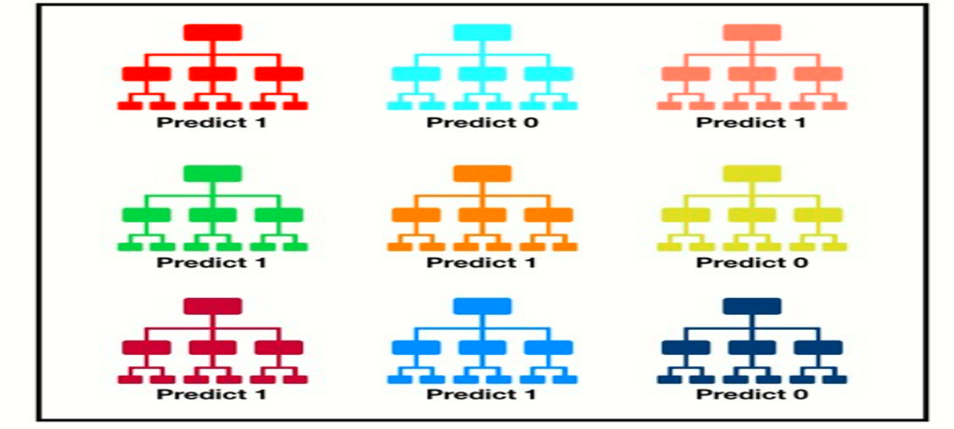
Why Random forest classifier?
The decision formed from considering many uncorrelated decision trees classification always produces accurate predictions on the whole compared to any individual model.
All the trees have a great feature to protect themselves from individual errors, some trees may be wrong and some of them may be right in prediction but as a group they are able to move in the correct direction, hence covering all the possible cases and approaching to an accurate prediction
The random forest classifier algorithm is very simple enough to get trained and can still produce accurate predictions.

Slide 24
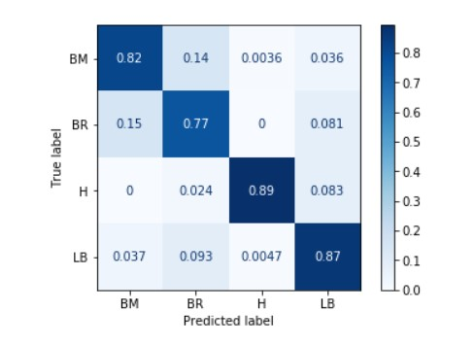
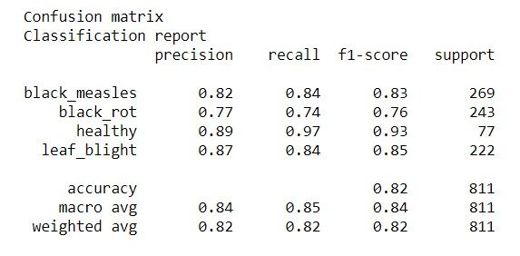
Experimental Results: Random Forest Model

Slide 25
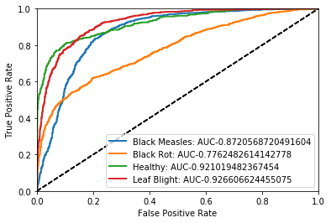
ROC – AUC and Tree Visualization
Tree using Graphviz Library

Slide 26
SUPPORT VECTOR MACHINE
SVM: Supervised leaning method for classification and regression
it finds a hyperplane in N dimensional space that distinctly classifies the data points. hyperplane must be the
one which has maximum distance from support vectors.
For non-linear data It uses kernel function to project data into high dimensional space and makes it linearly separable.
Linear kernel: given by product of two vectors
K(x, xi) = sum(x * xi)
Polynomial kernel: it can distinguish curved or non-linear input space
K(x , xi) = 1 + sum(x * xi)^d d=degree of polynomial
Radial Basis function kernel: it maps input space in infinite dimensional space
K(x , xi) = exp(-gamma * sum((x – xi^2))
gamma ranges 0-1

Slide 27
Why SVM?
SVM tries to finds the “best” margin that separates the classes and this reduces the risk of error on the data
Good Generalization properties
Can convert a constrained optimization problem to one that is easier to Solve
Effective when number of dimensions is greater than number of samples
We can add two kernel function to achieve complex hyperplane

Slide 28
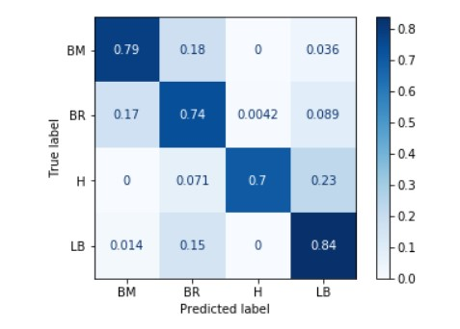
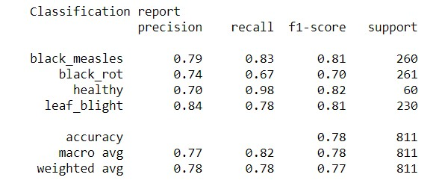
Experimental Results: Support Vector Machine

Slide 29
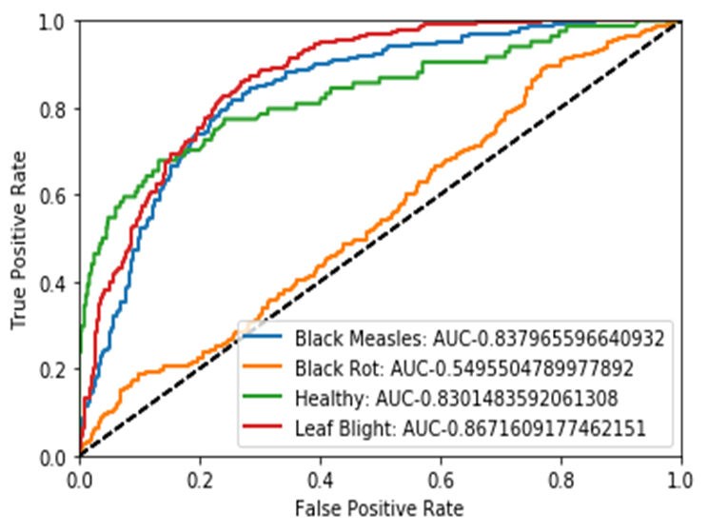
AUC-ROC CURVE

Slide 30
MODEL COMPARISION
Model | Justification
1] CNN | The main reason for using the CNN is that performing feature engineering is not required in this model. The understanding of an image in CNN good locally. Generally, the CNN Model has very high accuracy when it comes to the scenario of image classification.
2] VGG16 CNN | This is a pre-trained modular framework, used for the purpose of image classification. It is usually very good in the case of image classification, since it has 16 layers of convolution, pooling etc.
3] Random Forest | Random Forest tries to reduce the variance part of error rather than the bias part. It achieves a better accuracy on a new data set validation, and it is great at avoidance of overfitting.
4] Support Vector Machine | SVM tries to find the “best” margin that separates the classes and this reduces the risk of error on the data. Good Generalization properties. It is effective when number of dimensions is greater than number of samples

Slide 31
Project Workflow
Image Dataset
Support Vector Machine
Random Forest Classifier
CNN Model
VGG16 CNN
Disease or Not?
No
No disease
Classify the leaf
Yes
Black Rot
Black measles
Leaf Blight
Healthy

Slide 32
Results
Model used | Input Datatype
CNN Model | Images (Diseased leaves + healthy) | Accuracy:92.18%, loss: 22.61%, validation accuracy: 91.09%, validation loss:24.16%
VGG16 | Images (Diseased leaves + healthy) | Accuracy: 96%, loss: 19.72%, validation accuracy: 93.12%, validation loss: 27.92%
Random Forest | Images (Diseased leaves + healthy) | 82%
Support Vector Machine | Images (Diseased leaves + healthy) | 78%

Slide 33
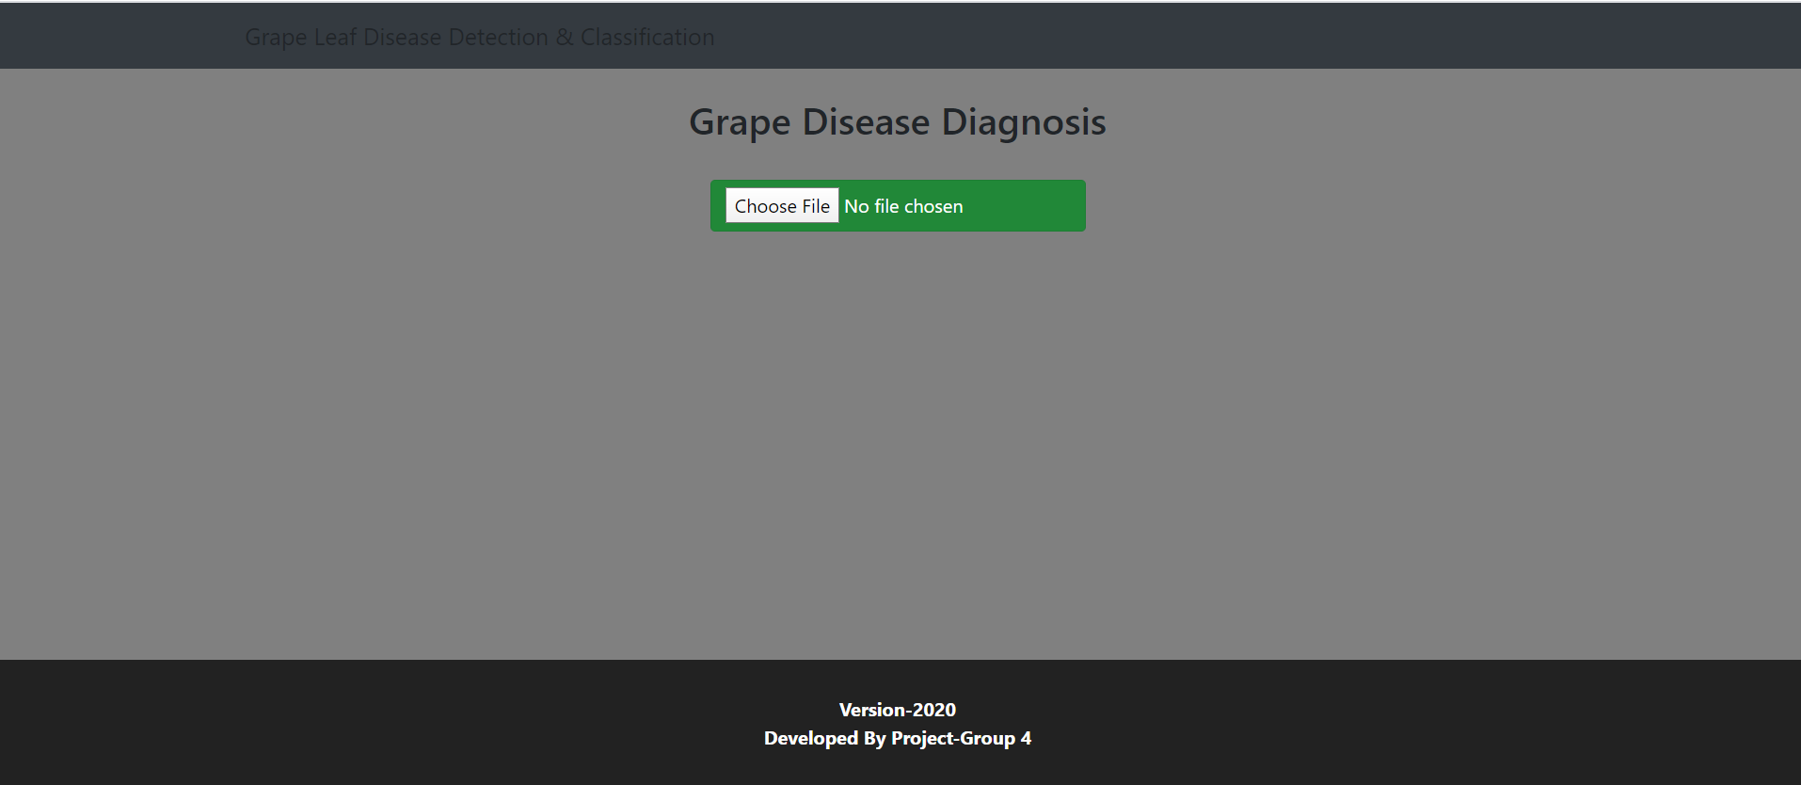
Web Application Developed for project purpose

Slide 34
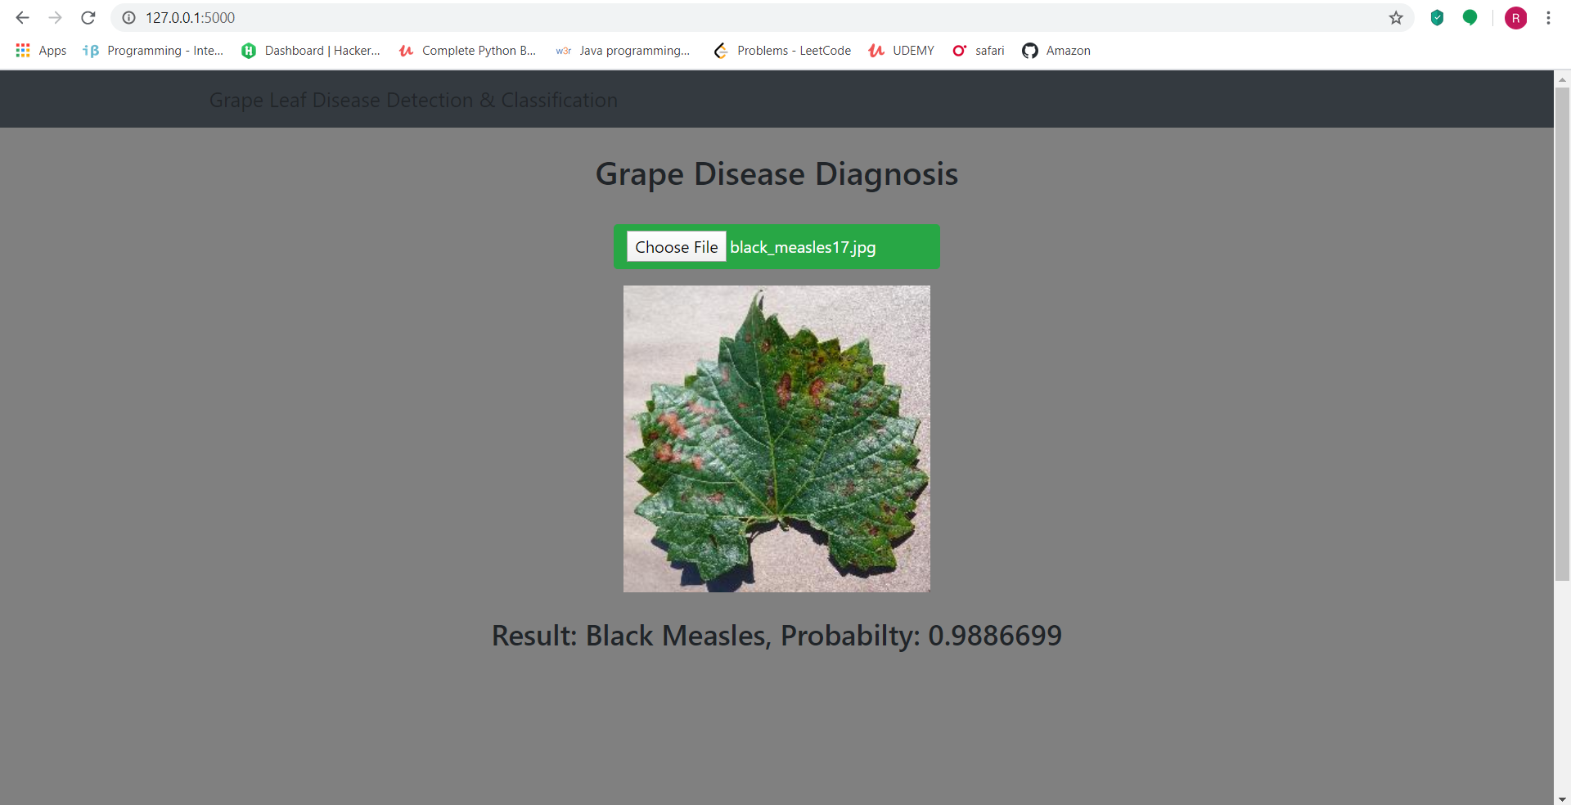
Predicted Class along with the probability

Slide 35
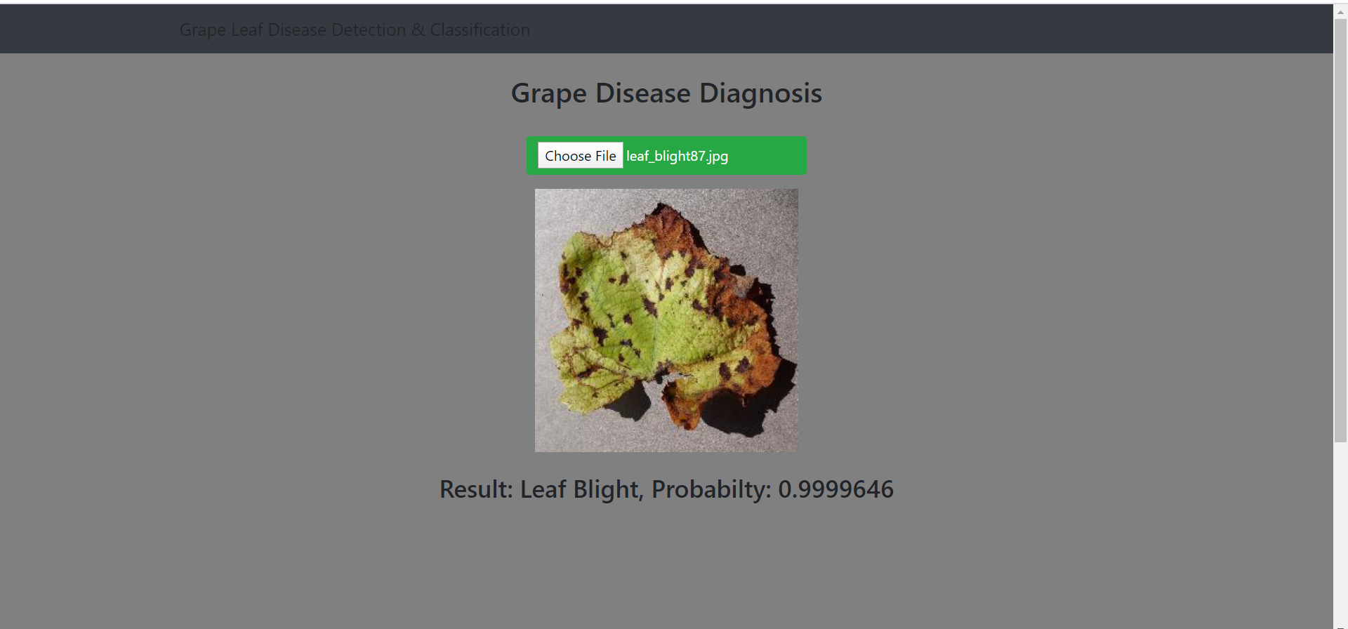
Predicted Class along with the probability

Slide 36
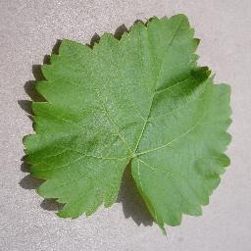
THANK YOU…!

